Slide 1
Social Studies PBL
Name of project: What Makes North Carolina Unique
Subject/Course: Social Studies
Teacher: Carri Kudla
Grade Level: 3rd Grade

Slide 2
Driving Question: How can we, as a tour guide, educate people on the three regions of North Carolina and what makes this state unique.

Slide 3
Sample North Carolina Travel Websites
http://www.north-carolina-tourism.com/
http://www.nccommerce.com/tourism
https://www.visitnc.com/things-to-do

Slide 4
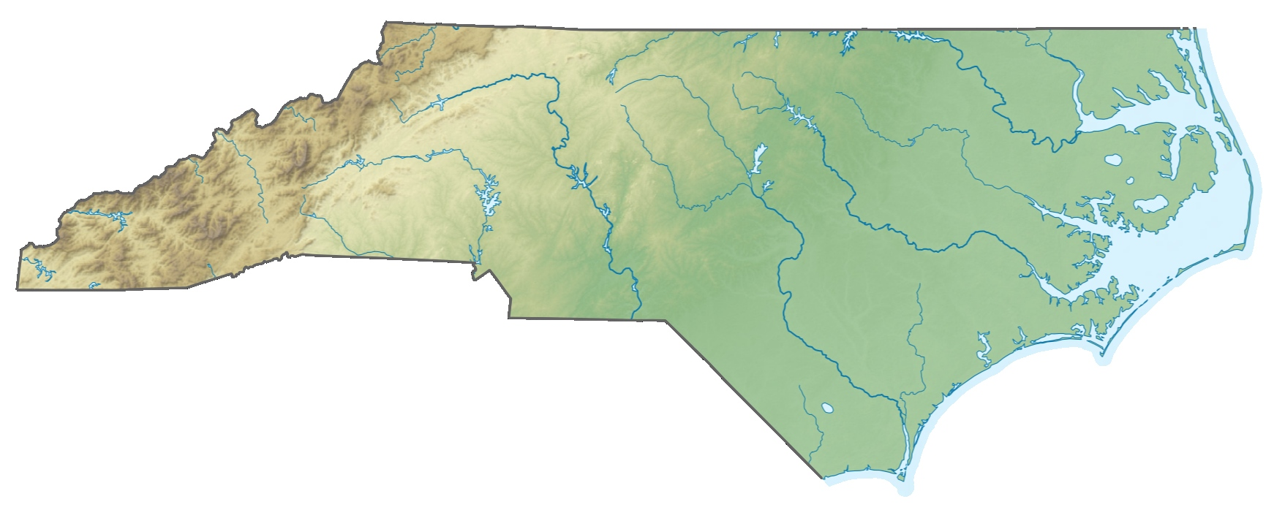
Content Standards: 3.G.1-Earth’s Patterns by using the 5 themes of geography: location, place, human-environment interaction, movement and regions. (NC 3 Regions)

Slide 5
Create a brochure on North Carolina using Discovery Board Builder or Google Slide
You want to:
persuade people to travel here from all over the world
educate people about our great state
tell them about the fun things that they can do in each region
tell them why North Carolina is unique
use your PBL rubric

Slide 6
Tour Guide Website PBL Rubric
My tour guide website on North Carolina will contain the following for each region:
At least two pictures on each region but not more than five
Identify 2-3 land features of the region
List 2-3 things to do in the region
Convince people that NC is a great place to visit

Slide 7
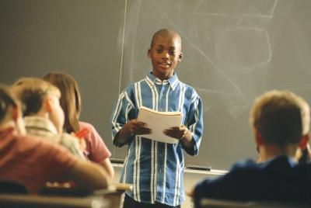
Presentation
I will use the presentation rubric that my teacher has provided to help with my group’s presentation.

Slide 8
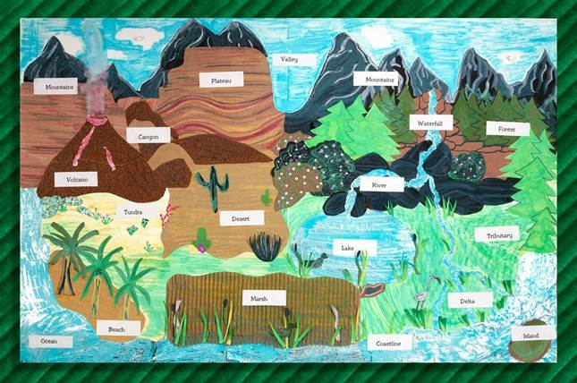
Additional Resources Landforms Video and Flip Book
https://www.youtube.com/watch?v=d_zOK4cLvU8

